Slide 1
Medicare Advantage Risk Adjustment Fraud: Does your plan’s strategy violate the False Claims Act?
Phillips & Cohen LLP
www.phillipsandcohen.com

Slide 2
Overview of Risk Adjustment Fraud
2
Risk adjustment fraud is essentially “upcoding” for diagnosis codes
  Traditional Upcoding: doctors and hospitals, paid by the procedure, claim payment for procedures they did not truly perform, or for a more complex version of the procedure they did perform
  Risk Adjustment Upcoding: Medicare Advantage (“MA”) HMOs, paid in large part by their members’ health status, claim payment for diagnoses they do not have/were not treated for

Slide 3
Principles of Risk Adjustment

Slide 4
Principles of Risk Adjustment
CMS pays Medicare Advantage HMOs on a capitated basis
  Per-member-per-month
CMS recognizes, however, the risk HMOs take by agreeing to insure beneficiaries for a flat monthly fee
  A single hospitalization costs an average of $10,000 and can wipe out the Medicare premiums the HMO received that year

Slide 5
Principles of Risk Adjustment
To help HMOs manage their risk, CMS created a system that increases its premium for beneficiaries who are receiving treatment for diseases that typically correspond to high costs
      The additional money comes in the form of an increased capitation rate:
        Member’s Capitation Rate = (The HMO’s Base Capitation Rate) x (The Member’s Risk Adjustment Multiplier)

Slide 6
Example: 76-year-old female with diabetes and renal failure
Condition | HCC | Adjustment
Female, 76 |  | 0.468
Diabetes (no complications) | 19 | 0.162
Renal failure | 131 | 0.368
Total |  | 0.998
Base PMPM | Multiplier | Adjusted PMPM
$800 | 0.998 | $798.4

Slide 7
Requirements for Risk Adjustment Claims
  The patient must have been treated that year
  Face-to-face
  By a qualifying provider
Notes:
“must be documented following CMS/ICD-9 guidelines”

Slide 8
Requirements for Risk Adjustment Claims
  CMS has rigid requirements about how plans qualify for increased risk adjustment payments
    The diagnosis codes must be documented in the medical record, following standard industry guidelines (ICD-9-CM)
    The diagnosis codes must stem from a face-to-face encounter between the physician and the patient
Notes:
“must be documented following CMS/ICD-9 guidelines”

Slide 9
Requirements for Risk Adjustment Claims
  To ensure these goals are met, CMS requires HMOs to follow its guidance as to what diagnosis codes they submit
    For example: HMOs cannot submit diagnosis codes taken from certain types of medical records, such as radiology and lab reports, because the records do not reflect a face-to-face physician encounter

Slide 10
Risk Adjustment Fraud and the False Claims Act

Slide 11
Risk Adjustment and the False Claims Act
The False Claims Act prohibits:
  knowingly presenting (or causing to be presented) to the federal government a false or fraudulent claim for payment or approval; and
  knowingly concealing or knowingly and improperly avoiding or decreasing an obligation to pay or transmit money or property to the Government.
31 U.S.C. § 3729(a)(1).

Slide 12
Risk Adjustment and the False Claims Act
Any person who violates the FCA is liable for a civil penalty of up to $11,000 for each violation, plus three times the amount of the damages sustained by the United States. 31 U.S.C. § 3729(a)(1).

Slide 13
Each Diagnosis Submitted to CMS is a Claim for Payment
With every diagnosis, HMOs submit information to CMS asserting the member has the diagnosed condition and received treatment for it:
      The member’s Health Insurance Claim (“HIC”) number
      The ICD-9-CM diagnosis code
      The “service from” date and “service through” date
      The provider type

Slide 14
Risk Adjustment and the False Claims Act
Each risk adjustment claim is itself a false statement, if the diagnosis is unsupported
No separate certification is required to establish falsity
That being said . . .

Slide 15
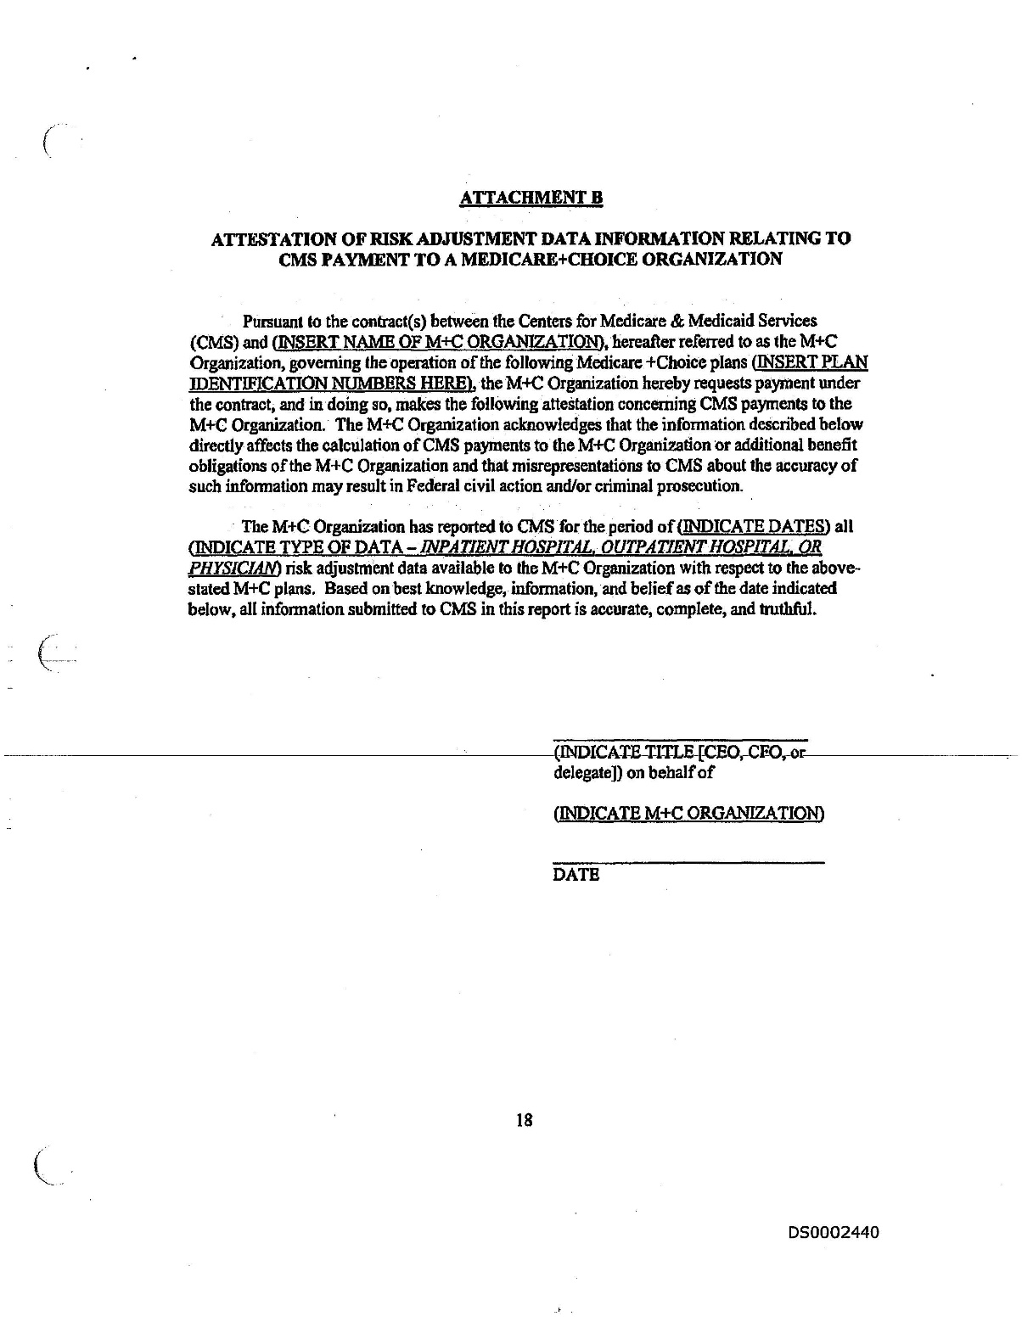
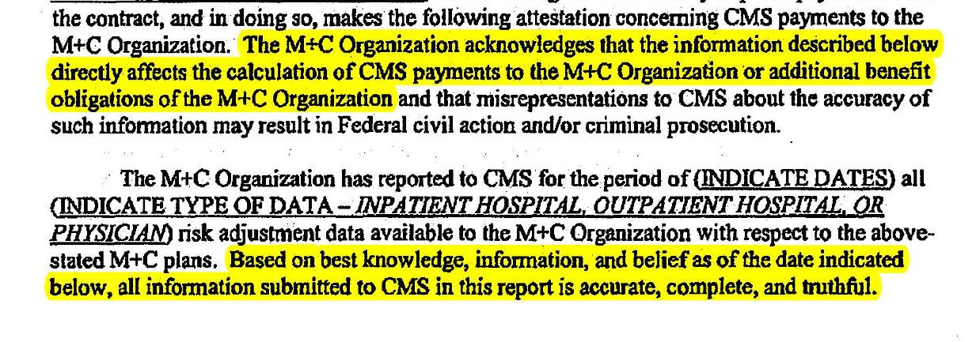
Medicare Advantage HMOs must attest to the accuracy of their risk adjustment data on an annual basis.

Slide 16
United States v. Janke

Slide 17
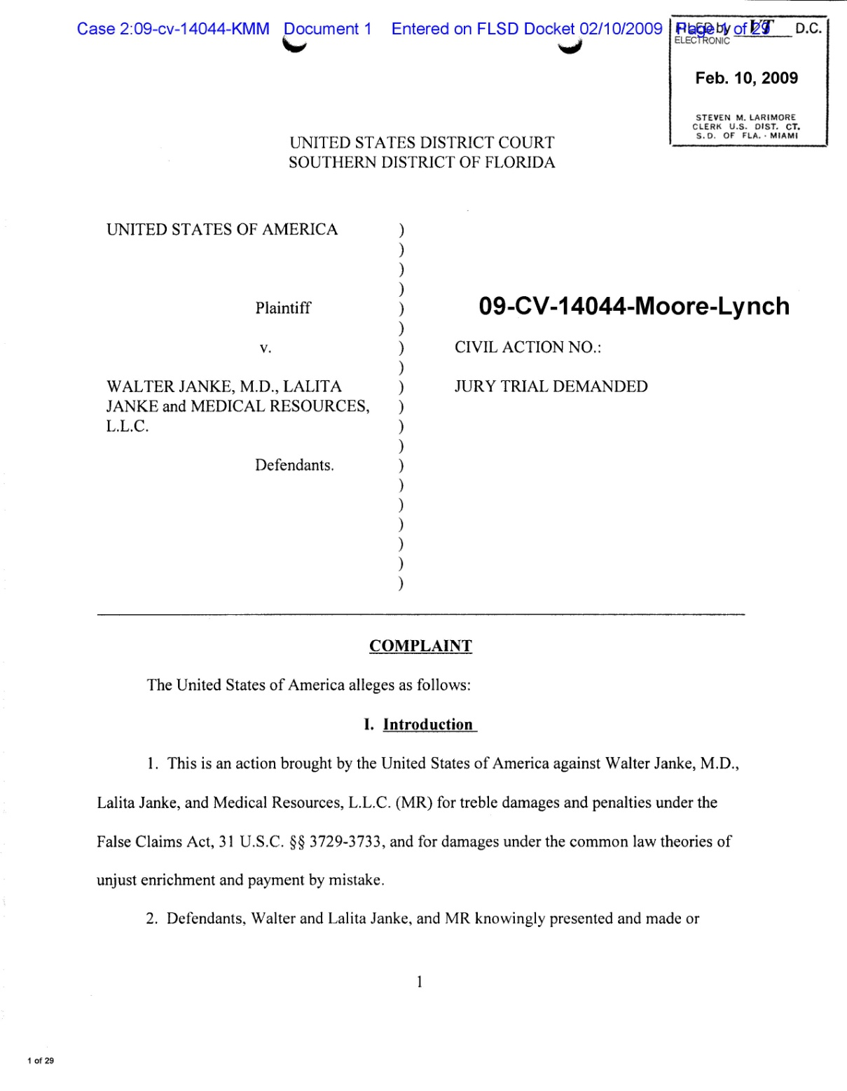
United States v. Janke, 09-CV-14044-Moore-Lynch (S.D. Fla. Feb. 10, 2009)
Settled for $22.6 million in November 2010

Slide 18
United States v. Janke
MA plan used coding reviewers to submit diagnosis codes to CMS that were not documented in the medical record or supported by an actual medical condition
  Data sweeps to find additional codes
MA plan submitted codes via an automated system that could not delete unsupported or false claims
  Example: reviewers are unable to submit delete codes when they find erroneous data (there is an “add” function, though)

Slide 19
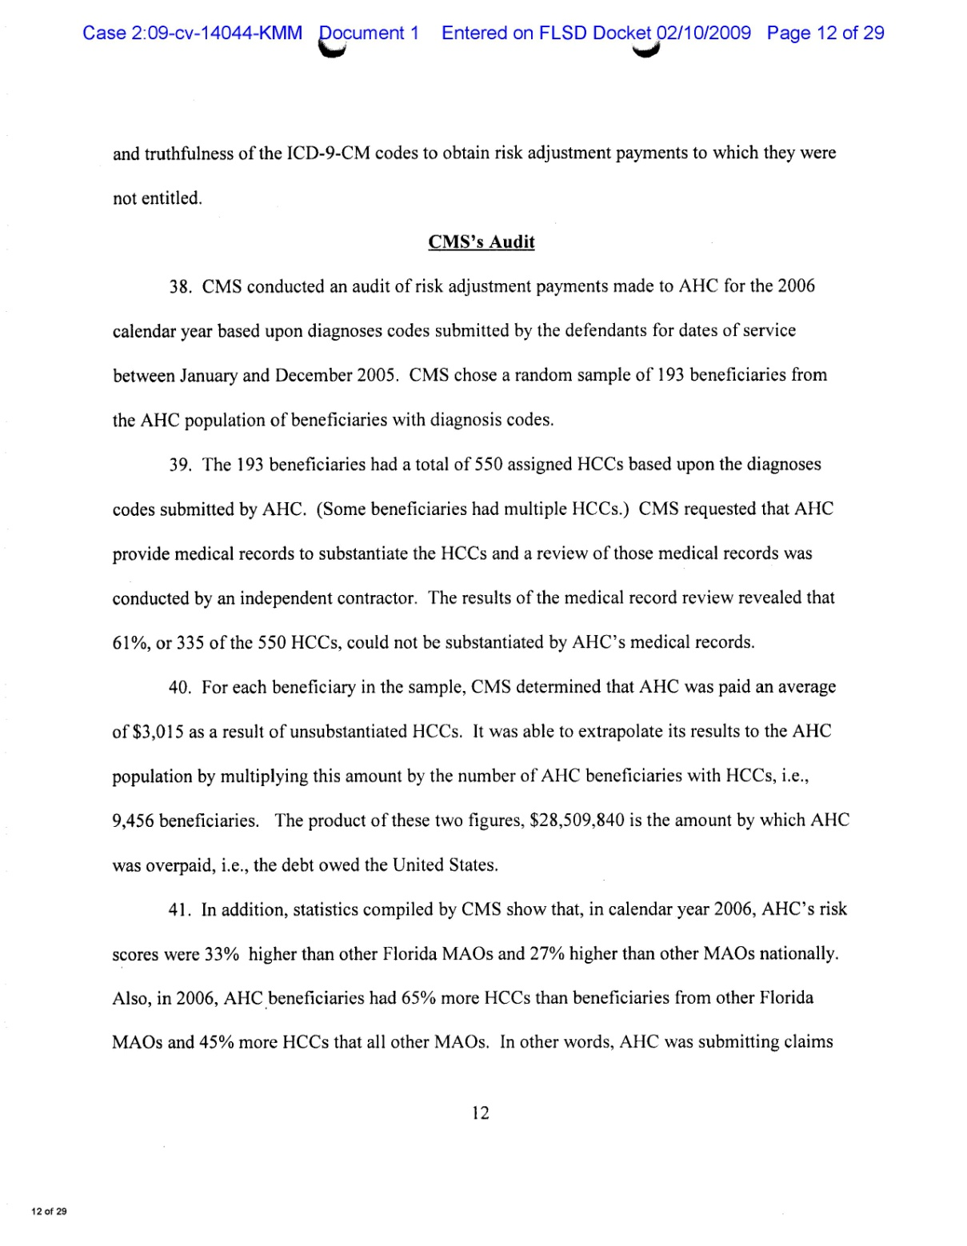
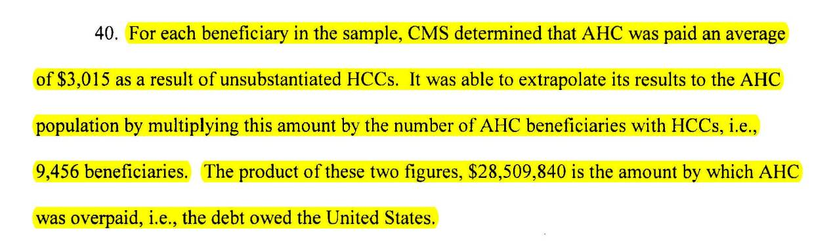
United States v. Janke, 09-CV-14044-Moore-Lynch (S.D. Fla. Feb. 10, 2009)
CMS Extrapolated Audit Results to Assess Damages from Risk Adjustment Fraud

Slide 20
Pending Unsealed Cases Involving Medicare Advantage Plans and Risk Adjustment Fraud

Slide 21
Pending unsealed cases
United States ex rel. Valdez v. Aveta, Inc. et al.,
No. 3:15cv1140 (D. P.R.)
  The complaint alleges that MA plans submitted inflated Risk Adjustment Factor scores based on diagnosis codes reported by Puerto Rican physicians and hospitals.
  The complaint alleges that risk scores were unsupported by the patients’ medical records.

Slide 22
Pending unsealed cases
United States ex rel. ex rel. Graves v. Plaza Medical Centers, et al., No. 8:13cv1348 (C.D. Cal.)
  In a recent ruling on a motion to dismiss, the district court upheld a magistrate judge’s opinion holding that a doctor systematically “upcoded” patient diagnoses to increase their risk adjustment factors, and a MA plan knowingly failed to correct the issues despite audits of patient files.

Slide 23
Pending unsealed cases
United States ex rel. Silingo, et al., v. Mobile Medical Examination Services Inc., et al., No. 1:10cv23382 (S.D. Fla.))
  The complaint alleges that defendant Mobile Medical Examination Services systematically upcoded patients to increase their risk scores without performing a face-to-face evaluation under the supervision of a physician.
  Health plans then “turned a blind eye to the truth” and failed to properly certify or validate the claims submitted by Mobile Medical Examination Services.

Slide 24
Pending unsealed cases
United States ex rel. Conte v. Blue Cross Blue Shield of South Carolina, et al., No. 3:13-cv-2251-CMC (D. S.C.)
  Due to a critical and fatal coding error, the Complaint alleges that procedure codes submitted to CMS by the defendants were inaccurate and unverifiable.
  According to the whistleblowers, the defendants were alerted to the coding errors and in fact forced them to stop submitting inaccurate, unverifiable false claims to the government, but the defendants refused to correct previous false claims submitted to the government and retaliated against one whistleblower.

Slide 25
Pending unsealed cases
United States ex rel. Ledesma v. Censeo Health LLC, et al., No. 3:14-CV-0118-M (N.D. Tx.)
  The Complaint alleges that the defendant developed an algorithm to identify patients who previously suffered from conditions that would increase their risk-adjusted capitation payments and sends “physicians” to conduct "in home assessments" of these patients, then submits the old diagnoses to CMS. These visits usually did not result in any follow-up care, but were rather exclusively to increase risk adjustment scores.
  These in-home assessments are, according to the whistleblower, not valid assessments but rather “self-reported conditions captured from the medical history and verbally confirmed” by the physician. Such “assessments” cannot form the basis for higher risk scores.
  The complaint also alleges that many of the physicians were not licensed to practice medicine.

Slide 26
Pending unsealed cases
United States ex rel. Valdez v. Aveta, Inc. et al.,
No. 3:15cv1140 (D. P.R.)
  The complaint alleges that MA plans submitted inflated Risk Adjustment Factor scores based on diagnosis codes reported by Puerto Rican physicians and hospitals.
  The complaint also alleges that risk scores were unsupported by the patients’ medical records.

Slide 27
Areas of Risk for the Submission of False Risk Adjustment Claims

Slide 28
Causes of False Claims:
Affirmative Upcoding
  Simple fraud – “making it up”
  Exaggerating severity of patient’s condition (e.g., depression, malnutrition)
  Claiming current treatment of condition (e.g., stroke, cancer) instead of past history of treatment
  Claims based on laboratory, radiology or other improper provider or service type
  Improperly linking complications and conditions

Slide 29
Causes of False Claims:
Business Practices and
Systemic Causes of Falsity
  Conducting chart reviews or other audits that only look for new risk adjustment claims
  Failure to properly filter data used to generate risk adjustment claims
  Compliance risk due to incentives to providers and failure to monitor provider submissions
  Compliance risk due to vendor business methods and incentives

